Slide 1
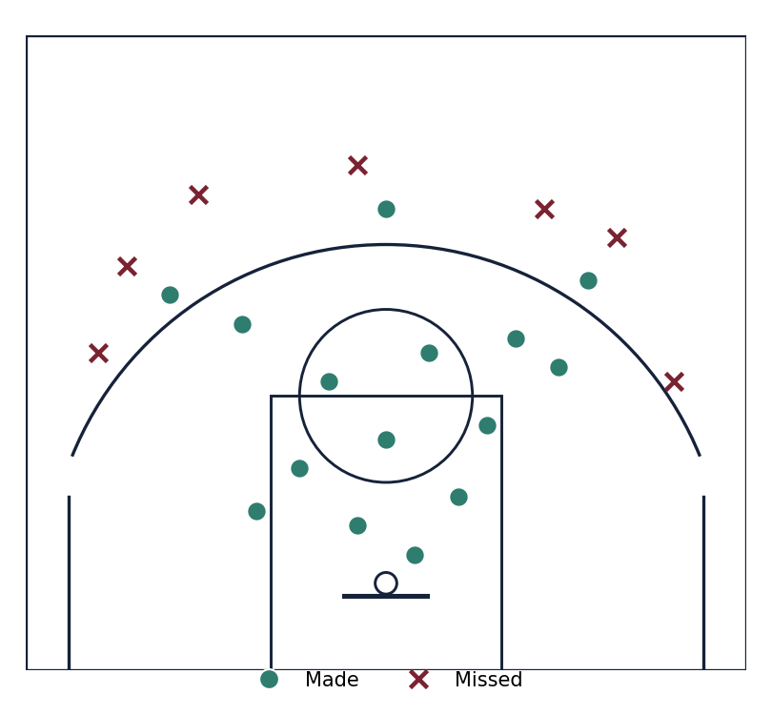
RIDGEWOOD ACADEMY VARSITY
TYLER FIELDS
Point Guard | Jersey 4 | 6 ft 1 in
Class of 2027
Recruiting profile and season summary, 2025 to 2026.
Prepared for college program review.
Tyler Fields, Recruiting Profile
Private and personal

Slide 2
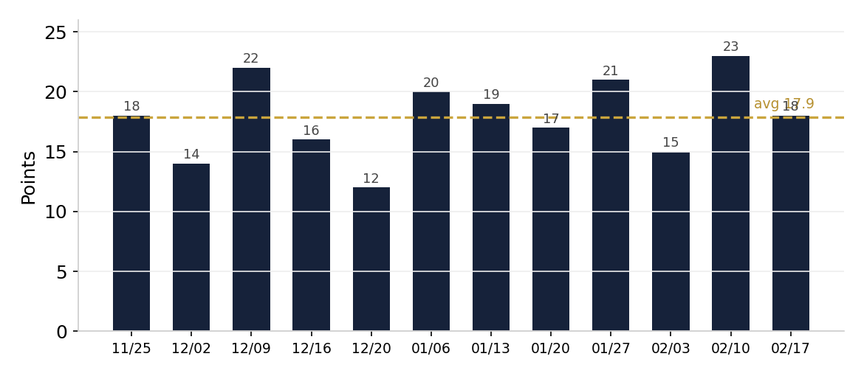
Player At A Glance
17.9
7.4
3.7
2.8
30.9
9-3
PPG
APG
RPG
SPG
MPG
Record
Points per game, full season
Attribute | Detail
Position | Point guard
Height | 6 ft 1 in
Class | 2027, junior
School | Ridgewood Academy
Coach | Dave Peterson
Interest | Business
Tyler Fields, Recruiting Profile
Private and personal

Slide 3
Season Game Log
Date | Opponent | Result | PTS | AST | REB | STL
Nov 25 | Worthington Kilbourne | W 61-54 | 18 | 7 | 4 | 3
Dec 09 | Upper Arlington | W 70-63 | 22 | 9 | 5 | 4
Dec 16 | Hilliard Davidson | W 66-59 | 16 | 8 | 2 | 2
Jan 06 | Grandview Heights | W 74-49 | 20 | 6 | 3 | 5
Jan 13 | Dublin Jerome | W 63-60 | 19 | 10 | 5 | 3
Jan 27 | Dublin Coffman | W 64-61 | 21 | 7 | 3 | 3
Feb 10 | Hilliard Davidson | W 71-58 | 23 | 9 | 2 | 4
Feb 17 | Westerville Central | W 60-57 | 18 | 8 | 5 | 3
Highlight: nineteen points and ten assists at Dublin Jerome, the game that drew college interest.
Tyler Fields, Recruiting Profile
Private and personal

Slide 4
Goals and Next Steps
Keep cumulative grade point average above 3.5
Attend the October prospect camp
Add a strength and conditioning block
Film every home game for recruiters
Visit two campuses this spring
Family and coaching contacts
Contact | Role | Reach
Joseph Fields | Father, guardian | Text first
Dave Peterson | Head coach | Ridgewood Academy
Megan Fields | Guardian | Co-parent
Schedule, transcripts, and game film available on request.
Tyler Fields, Recruiting Profile
Private and personal

